Slide 1
Cryptograph
Grace L.jy
Grace L.jy©

Slide 2
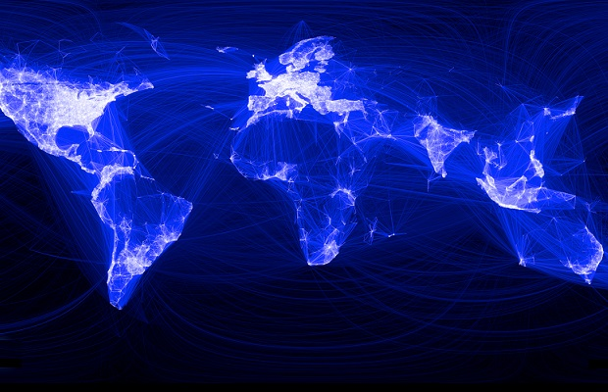
Internet allowing us to communicate across the globe.
Grace L.jy©

Slide 3
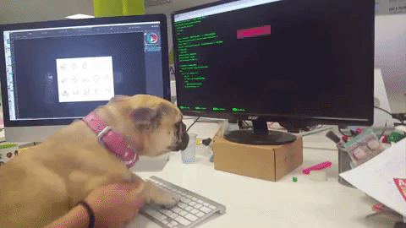
but not everyone who uses these networks is going to play by the rules or have our best interests at heart. We need cyber security to minimize crime and harm in the virtual world.
Grace L.jy©

Slide 4
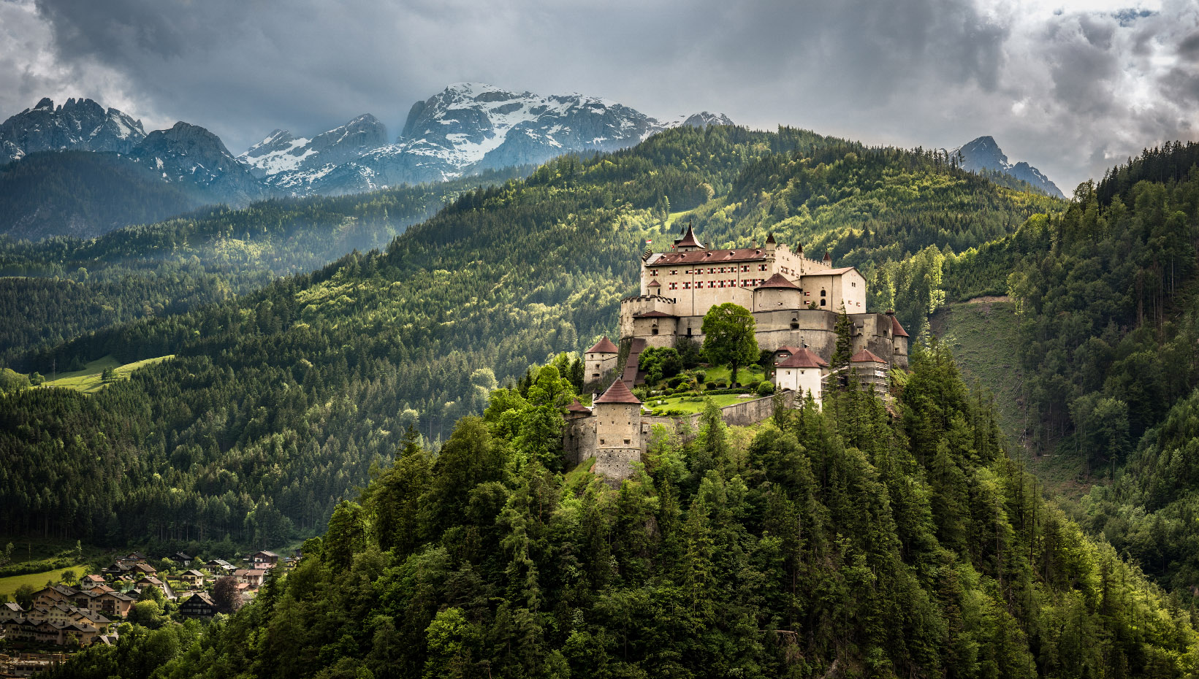
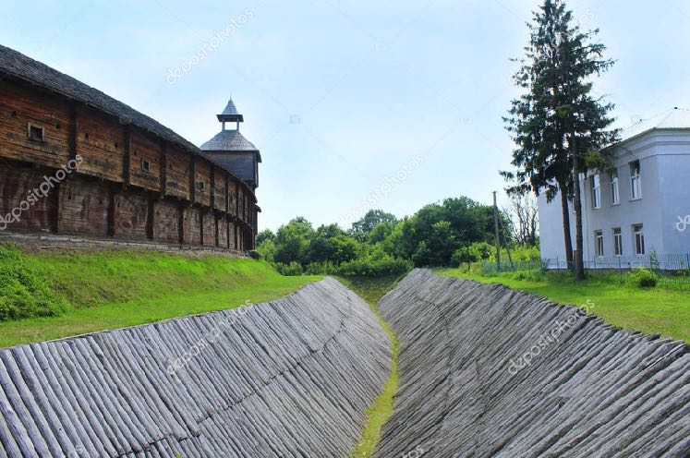
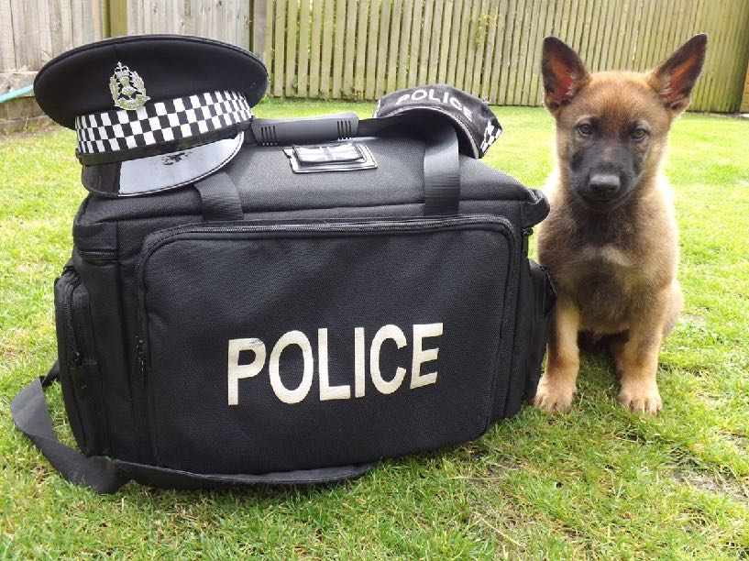
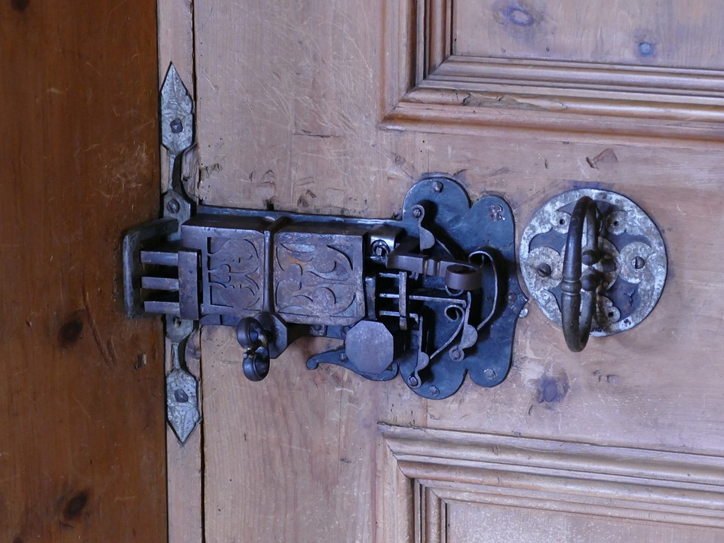
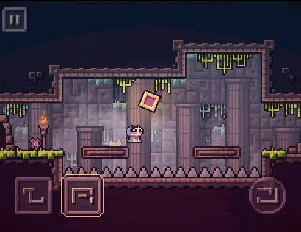
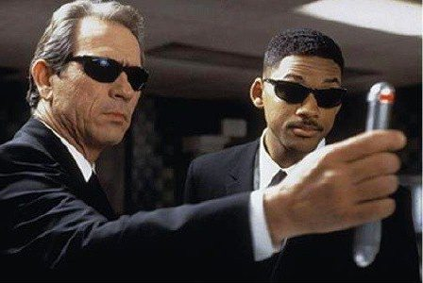
Defense in Depth
Cross the Moat
Police
Forced open the Lock
Defeat the Guards
Cross the Obstacles
Grace L.jy©

Slide 5

Cryptography
the most common forms of computer security.
secret writing
use a cipher, an algorithm that coverts plain text into cipher text.
Ciphers have been used long before computer showed up.
Grace L.jy©

Slide 6
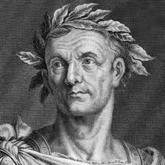
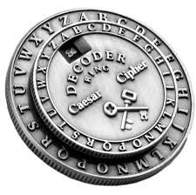
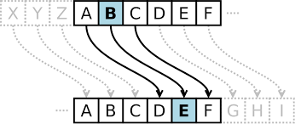
Julius caesar
(100 B.C. – 44 B.C.)
used whats now called “caesar cipher” to encrypt private correspondence.
shifting the letters in a message forward by three places, then A became D,
to decipher the message: both the algorithm and the number to shift by.
Grace L.jy©

Slide 7
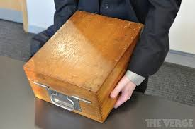

German Enigma
by 1900s, encryption machines showed up. the most famous one is the German Enigma, used by the Nazis to encrypt their wartime communications
The Enigma was a typewriter-like machine, with a keyboard and lampboard, both showing the full alphabet,
Grace L.jy©

Slide 8
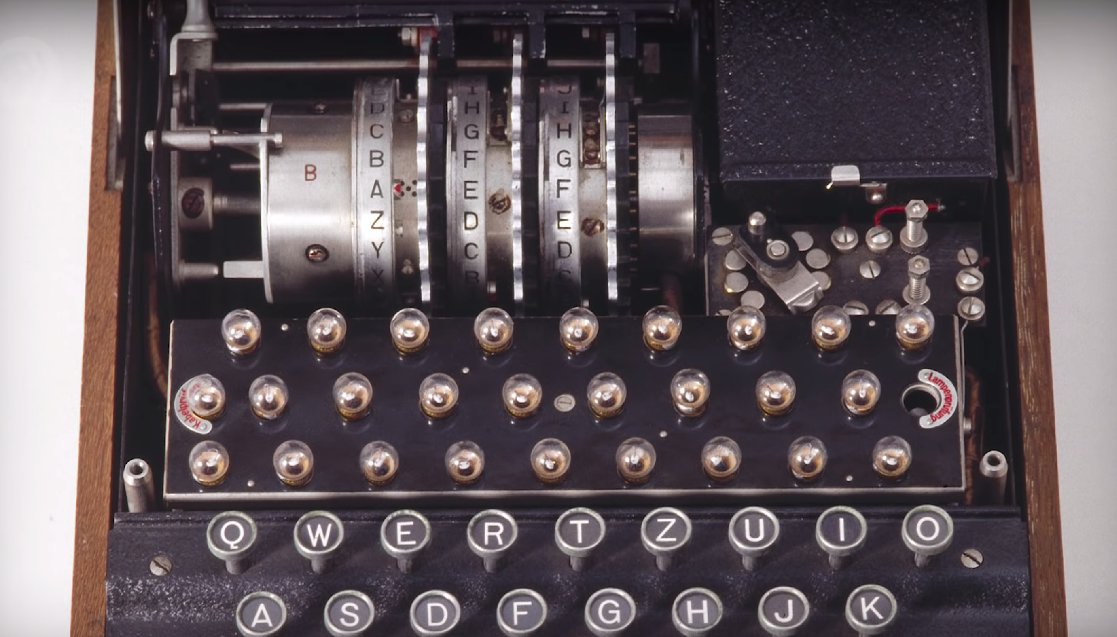
Grace L.jy©

Slide 9
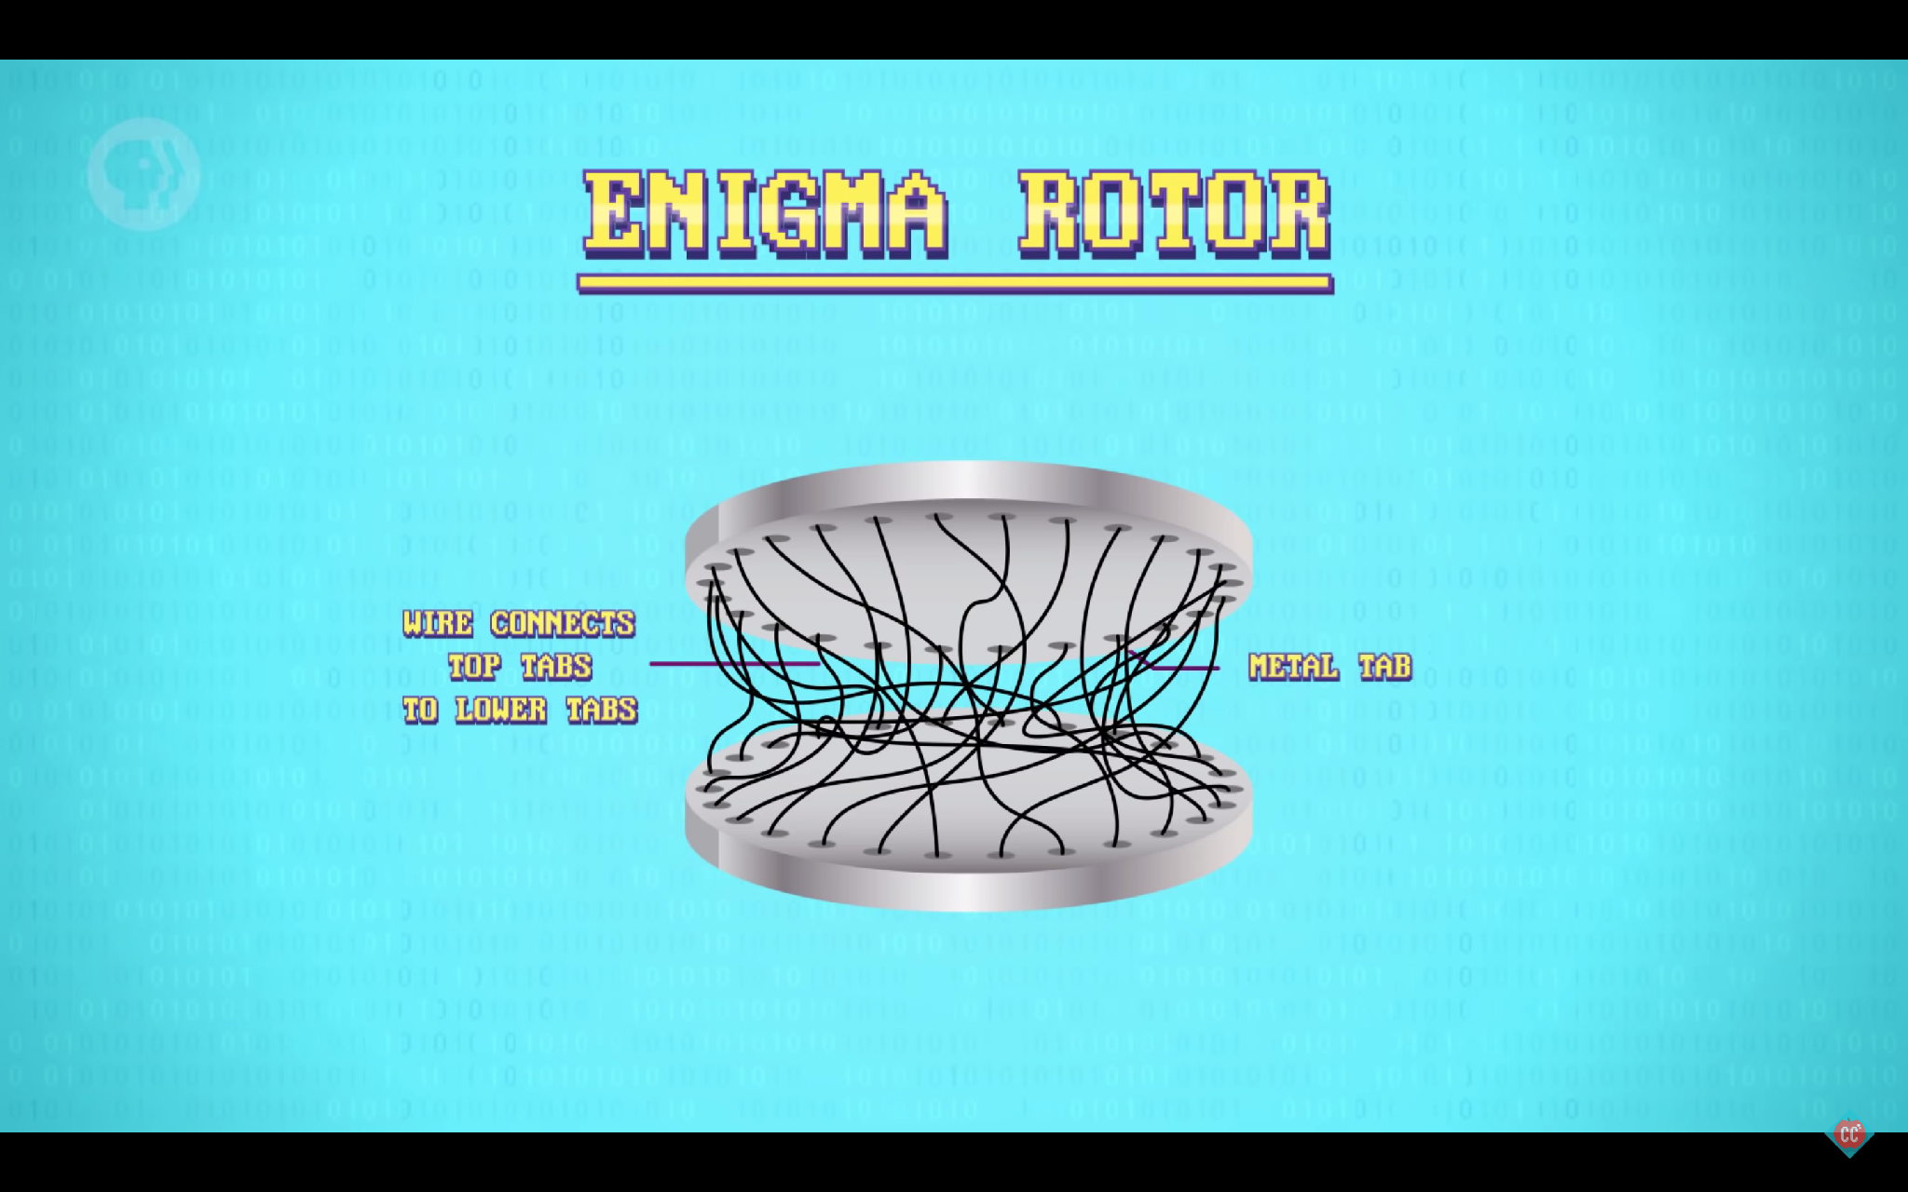
Grace L.jy©

Slide 10
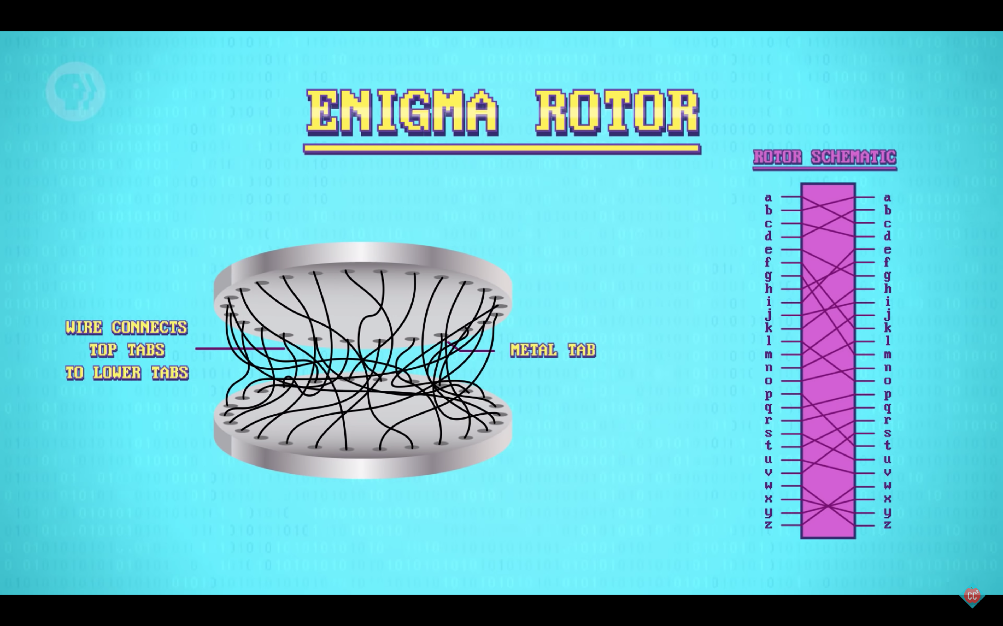
Grace L.jy©

Slide 11
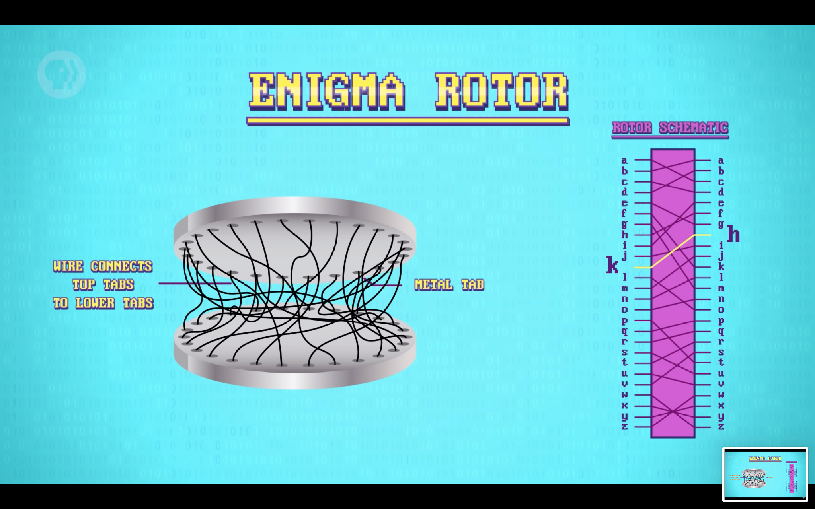
Grace L.jy©

Slide 12
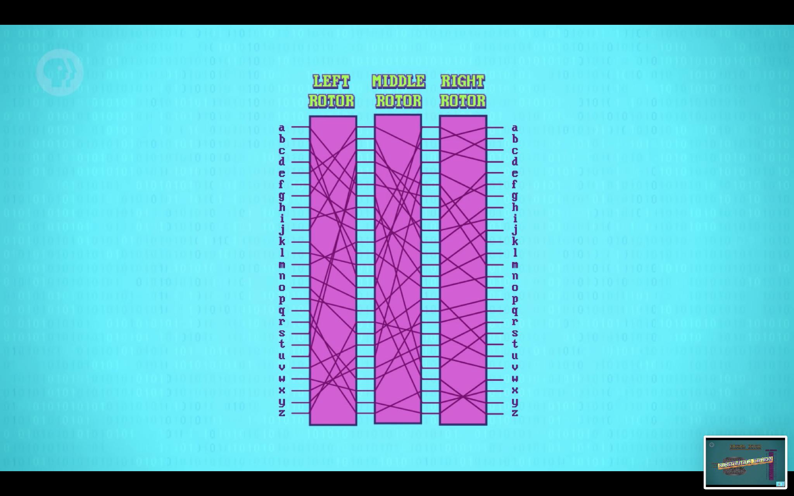
Grace L.jy©

Slide 13
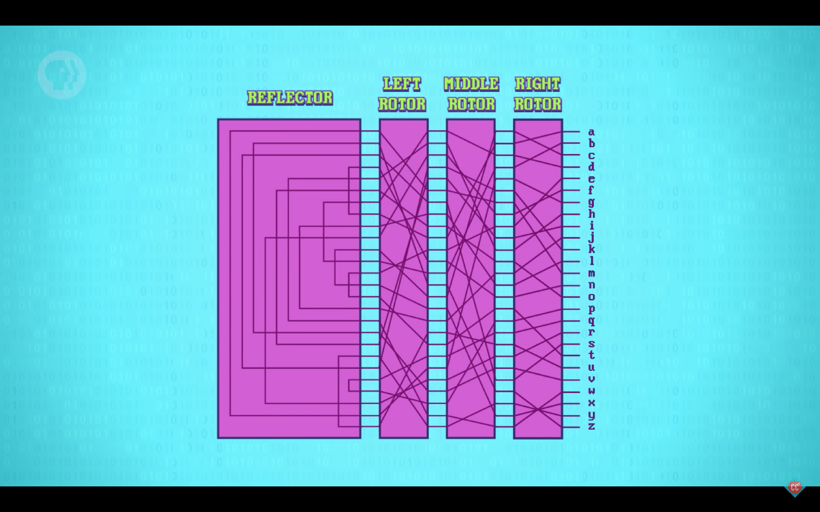
Grace L.jy©

Slide 14
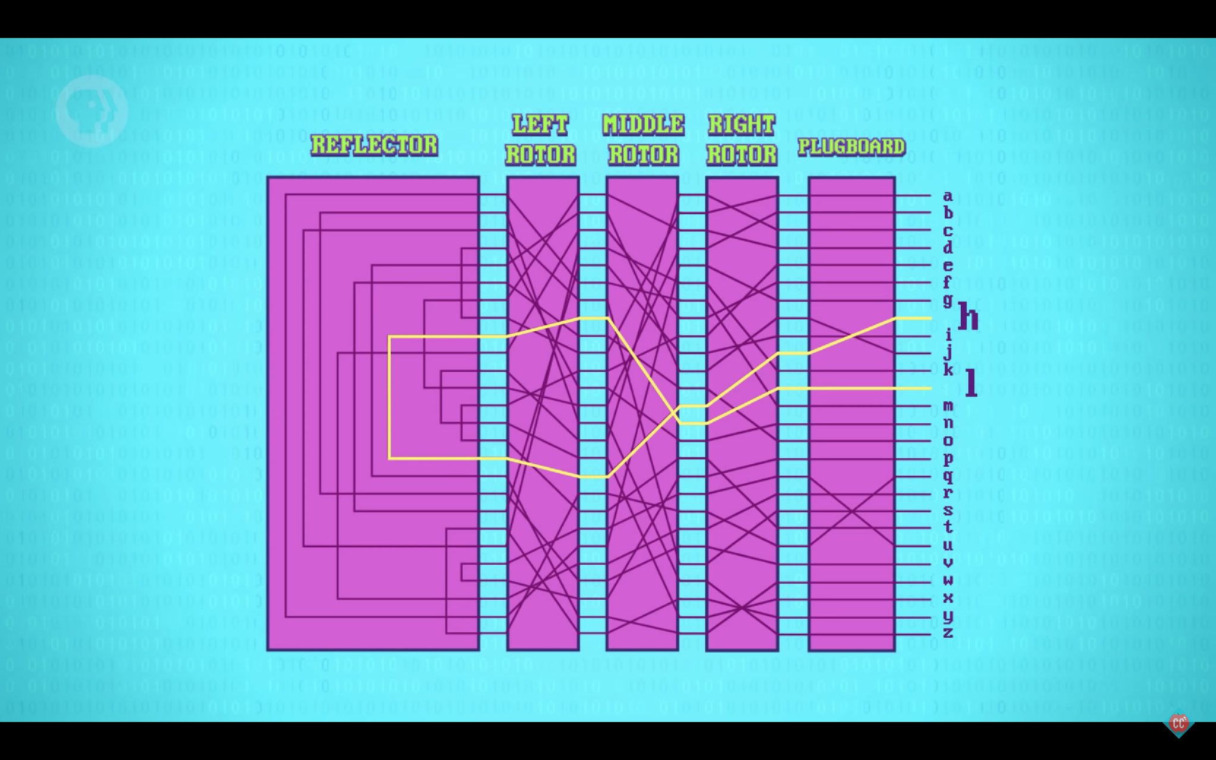
Grace L.jy©

Slide 15
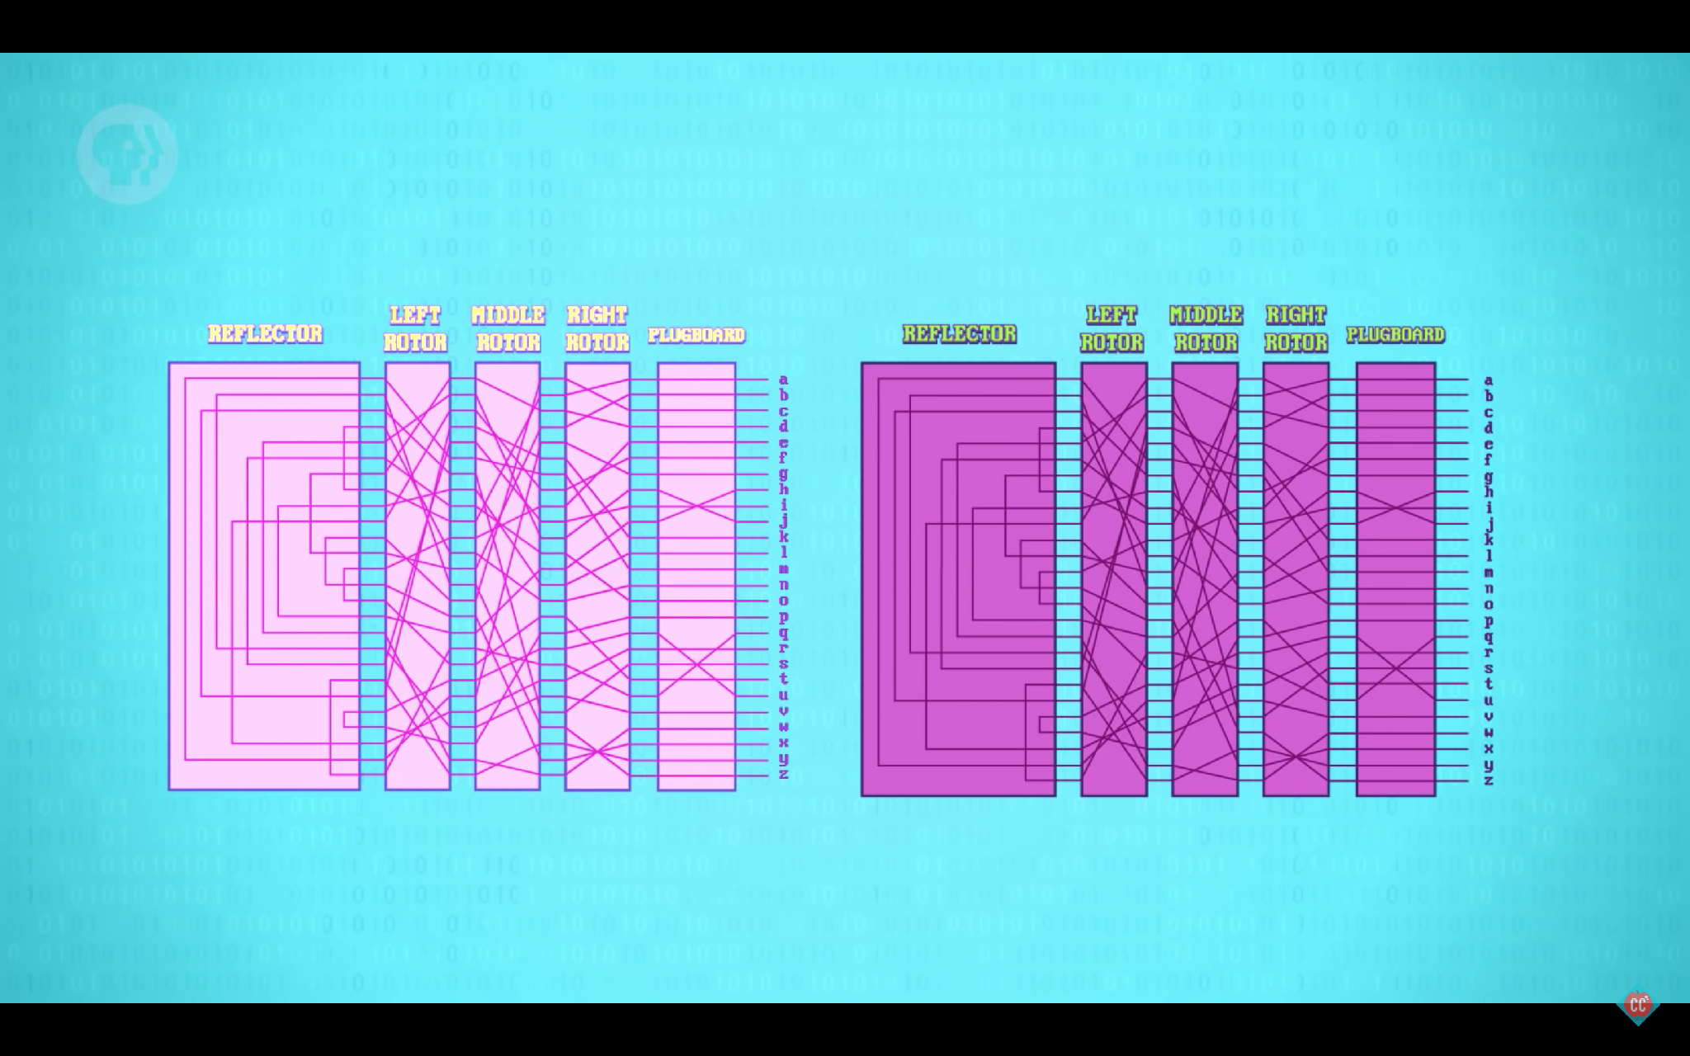
Grace L.jy©

Slide 16
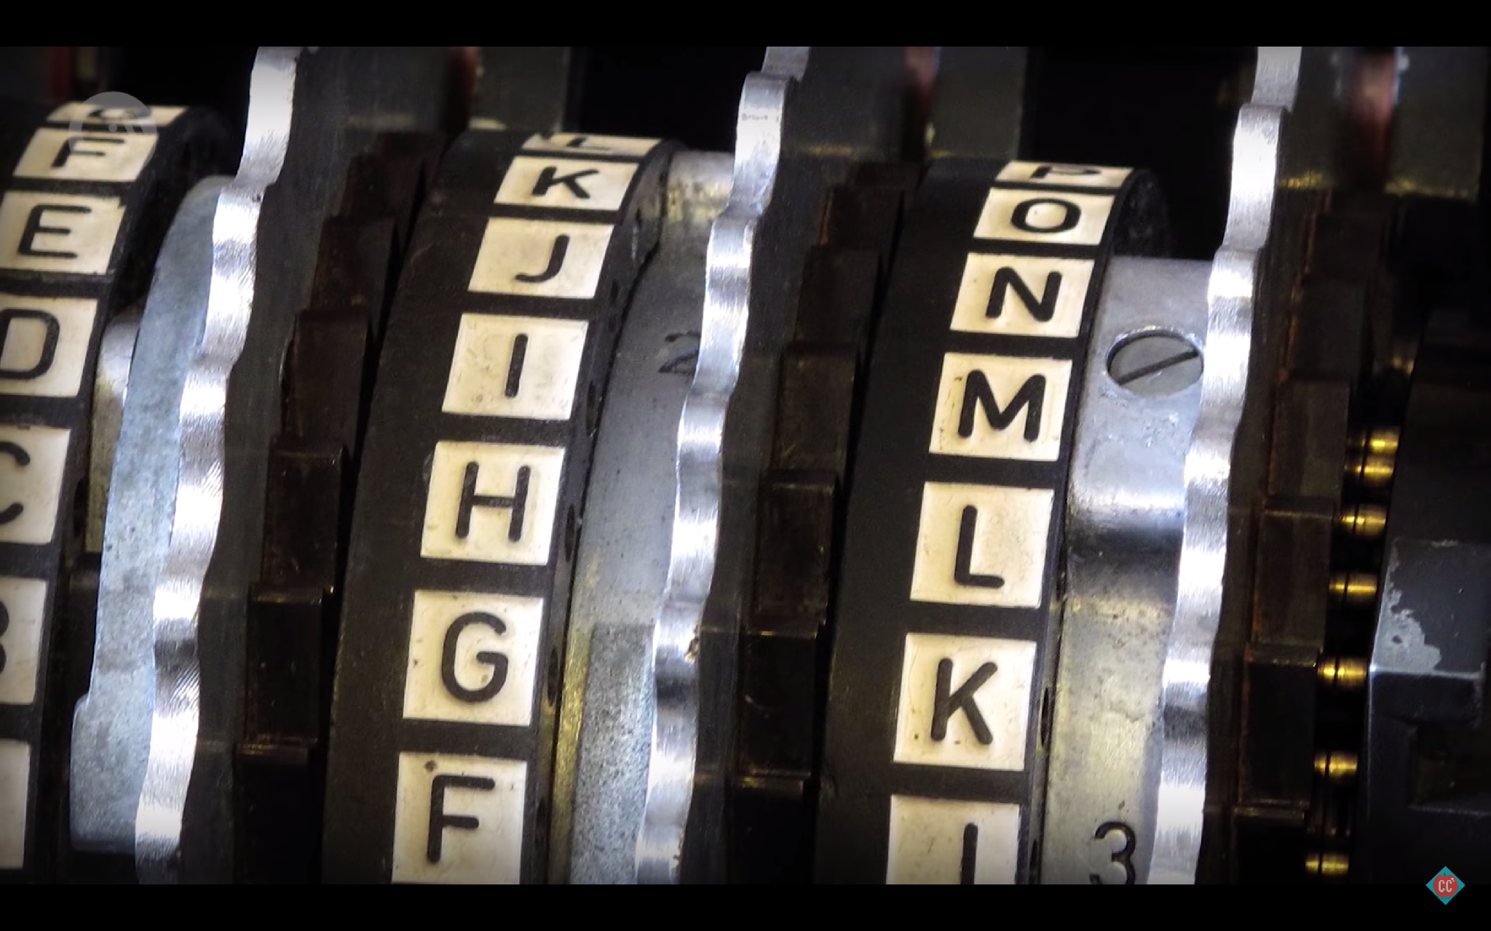
Alan Turing and his colleagues broke Enigma codes and largely automate the process.
Grace L.jy©

Slide 17
To be continue…
Grace L.jy©

